Slide 1
Instruction Set of 8085
11
Consists of
74 operation codes, e.g. MOV, MVI
246 Instructions, e.g. MOV A,B, MVI A,03
8085 instructions can be classified as
Data Transfer (Copy)
Arithmetic
Logical and Bit manipulation
Branch
I/O stack and Machine Control
JIIT-128, Noida

Slide 2
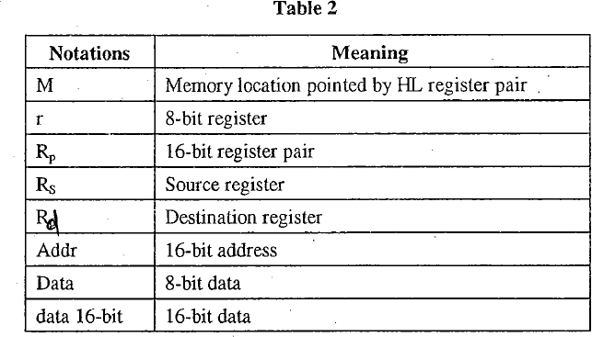
Notation used in instructions
Figure 1[1] Notation used in the instruction set

Slide 3
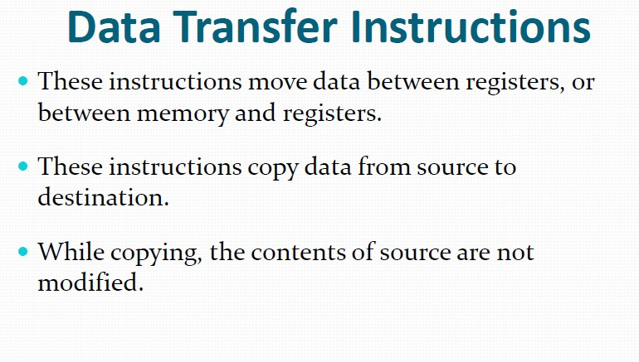
13
8085 Instruction Set

Slide 4
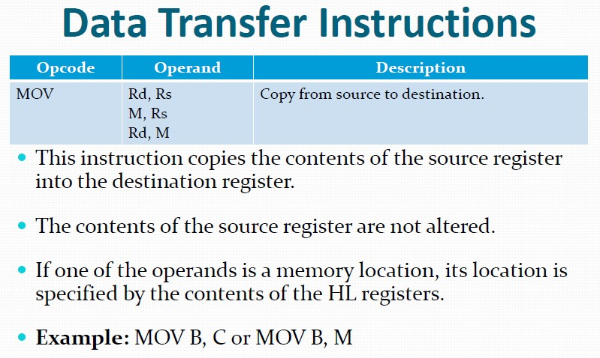
14
8085 Instruction Set

Slide 5
MOV E, M
 | Before | After
(E) | DBH | AAH
(HL) | 4050H | 4050H
(4050H) | AAH | AAH
Address | Hex Codes | Mnemonic | Comment
2008 | 2A | MOV E, M | Comment E <- Content of the memory location pointed by HL register pair
1-Byte

Slide 6
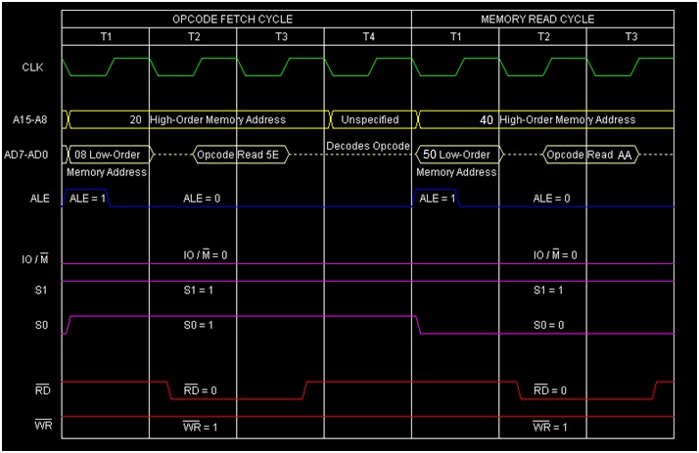

Slide 7
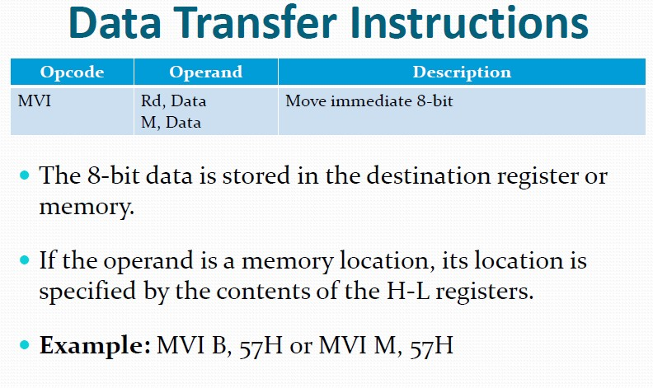
15
8085 Instruction Set

Slide 8
MVI E, ABH
Address | Hex Codes | Mnemonic | Comment
2000 | 1E | MVI E, ABH | E <- ABH
2001 | AB |  | ABH as operand

Slide 9
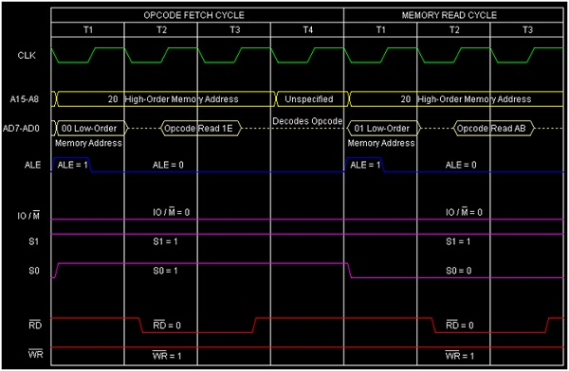
So this instruction MVI E, ABH requires 2-Bytes, 2-Machine Cycles (Opcode Fetch and Memory Read) and 7 T-States for execution as shown in the timing diagram.

Slide 10
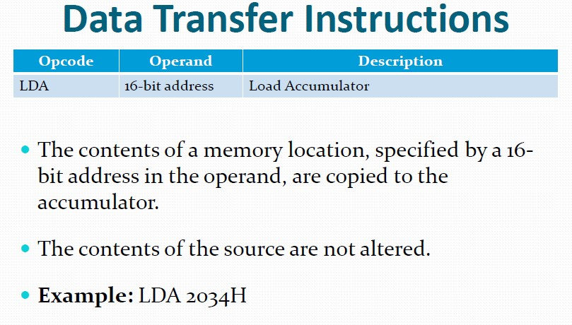
16
8085 Instruction Set

Slide 11
LDA 4050H
3-Byte instruction.
 | Before | After
(4050) | ABH | ABH
A | CDH | ABH
Address | Hex Codes | Mnemonic | Comment
2008 | 3A | LDA 4050H | A <- Content of the memory location 4050H
2009 | 50 |  | Low order Byte of the address
200A | 40 |  | High order Byte of the address

Slide 12
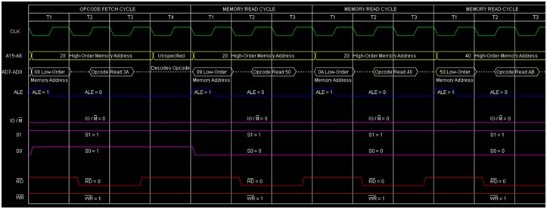
So this instruction LDA 4050H requires 3-Bytes, 4-Machine Cycles (Opcode Fetch, Memory Read, Memory Read, Memory Read) and 13 T-States for execution as shown in the timing diagram.

Slide 13
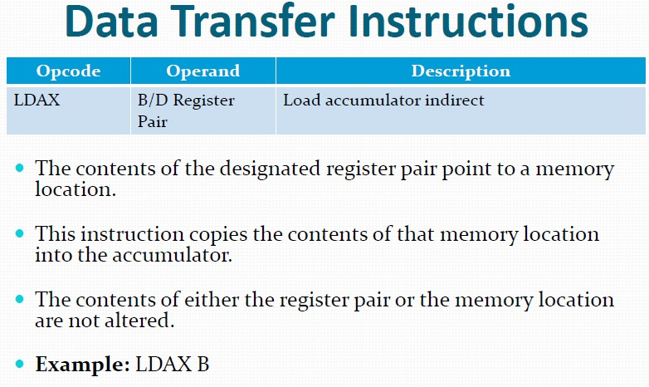
17
8085 Instruction Set

Slide 14
LDAX B
 | Before | After
(BC) | 4050H | 4050H
(4050H) | ABH | ABH
A | CDH | ABH
1-Byte instruction
Address | Hex Codes | Mnemonic | Comment
2008 | 0A | LDAX B | A <- Content of the memory 4050H

Slide 15
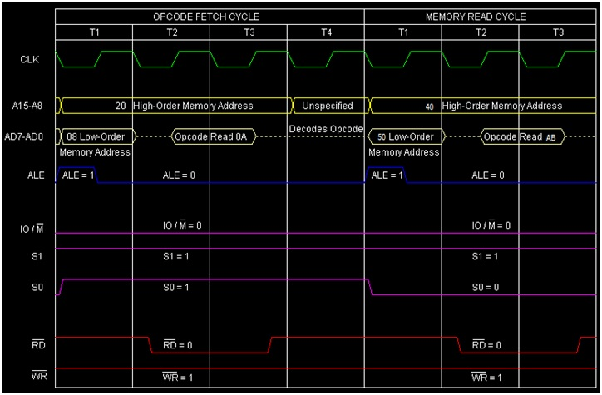
So this instruction LDAX B requires 1-Byte, 2-Machine Cycles (Opcode Fetch, Memory Read) and 7 T-States for execution as shown in the timing diagram.

Slide 16
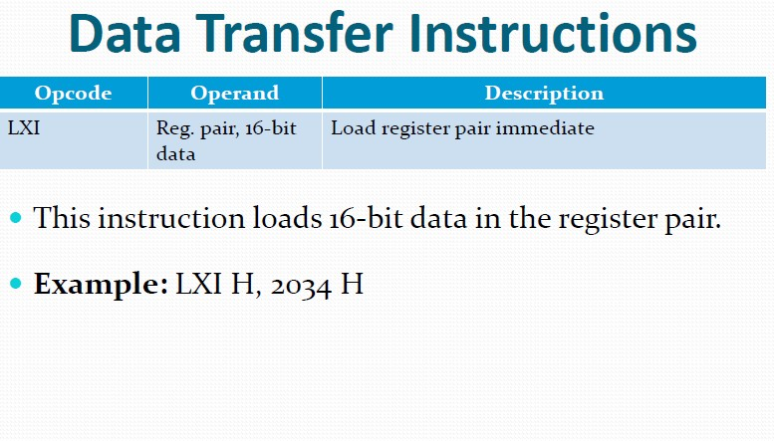
18
8085 Instruction Set

Slide 17
LXI D, 56FEH
56FEH is loaded into the DE register pair.
Address | Hex Codes | Mnemonic | Comment
 | 11 FE 56 | LXI D, 56FEH | Store 56FEH into the DE Register Pair.
8000
8001
8002
3-Bytes instruction

Slide 18
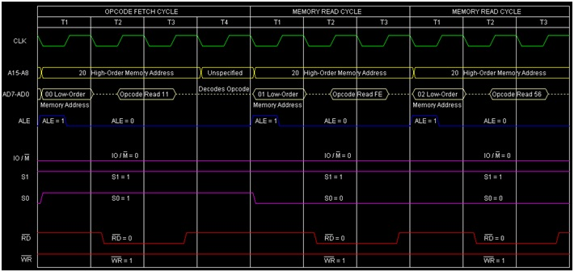

Slide 19
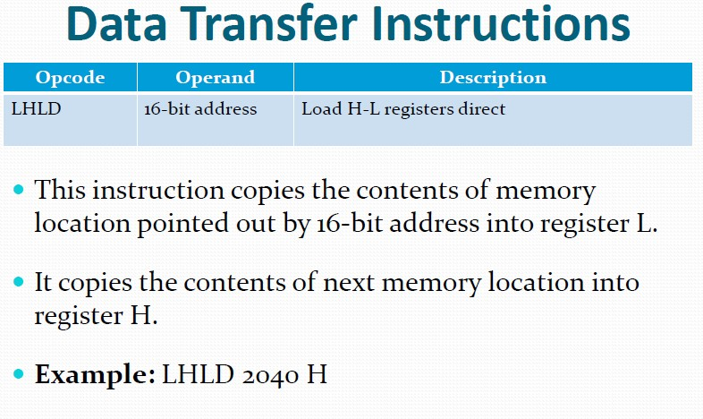
19
8085 Instruction Set

Slide 20
LHLD 4050H
 | Before | After
(4050H) | BBH | BBH
(4051H) | AAH | AAH
(H) | CCH | AAH
(L) | DDH | BBH
ddress | Hex Codes | Mnemonic | Comment
200B | 2A | LHLD 4050H | Initialize HL register pair from 4050H and 4051H memory locations’ contents.
200C | 50 |  | Low order Byte of the address
200D | 40 |  | High order Byte of the address

Slide 21
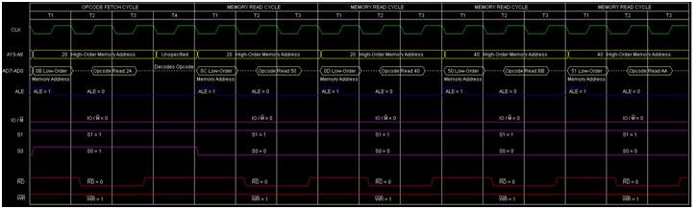
So this instruction LHLD 4050H requires 3-Bytes, 5-Machine Cycles (Opcode Fetch, Memory Read, Memory Read, Memory Read, Memory Read) and 16 T-States for execution as shown in the timing diagram.

Slide 22
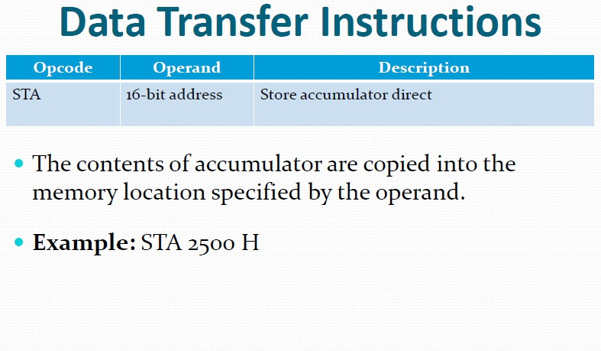
20
8085 Instruction Set

Slide 23
STA 4050H
 | Before | After
(A) | ABH | ABH
(4050H) | CDH | ABH
Address | Hex Codes | Mnemonic | Comment
2008 | 2A | STA 4050H | Content of the memory location 4050H <- A
2009 | 50 |  | Low order Byte of the address
200A | 40 |  | High order Byte of the address
3-Byte instruction.

Slide 24
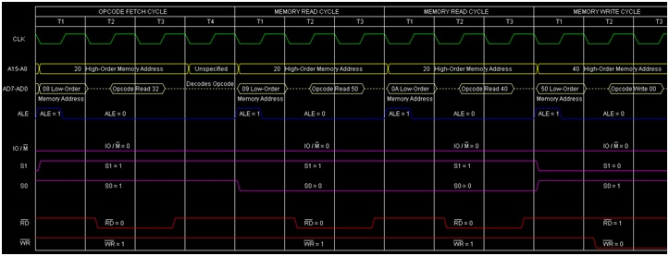
So this instruction SDA 4050H requires 3-Bytes, 4-Machine Cycles (Opcode Fetch, Memory Read, Memory Read, Memory Write) and 13 T-States for execution as shown in the timing diagram.

Slide 25
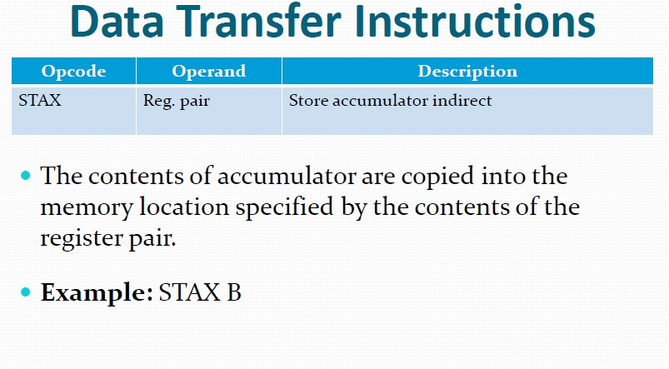
21
8085 Instruction Set

Slide 26
STAX B
 | Before | After
(BC) | 4050H | 4050H
(A) | ABH | ABH
(4050h) | CDH | ABH
Address | Hex Codes | Mnemonic | Comment
2006 | 02 | STAX B | Content of the memory location pointer by BC register pair <- A
1-Byte instruction.

Slide 27
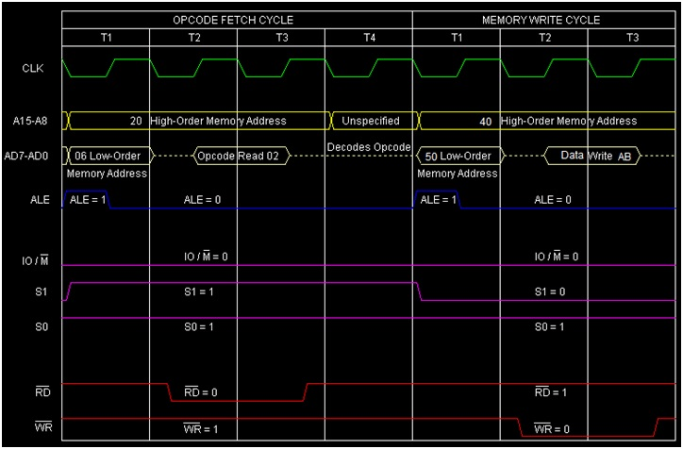

Slide 28
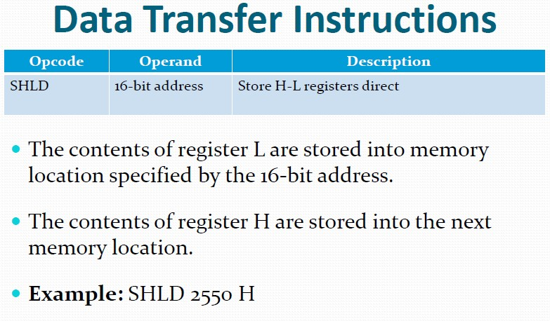
22
8085 Instruction Set

Slide 29
SHLD 4050H
 | Before | After
(H) | BBH | BBH
(L) | AAH | AAH
(4050H) | CCH | AAH
(4051H) | DDH | BBH
Address | Hex Codes | Mnemonic | Comment
200B | 22 | SHLD 4050H | Store HL register pair’s content to memory locations 4050H and 4051H respectively.
200C | 50 |  | Low order Byte of the address
200D | 40 |  | High order Byte of the address
3-Byte instruction

Slide 30
SHLD 4050H
 | Before | After
(H) | BBH | BBH
(L) | AAH | AAH
(4050H) | CCH | AAH
(4051H) | DDH | BBH
4050H
CCH
4050H
AAH
4051H
DDH
SHLD 4050H
4051H
BBH

Slide 31
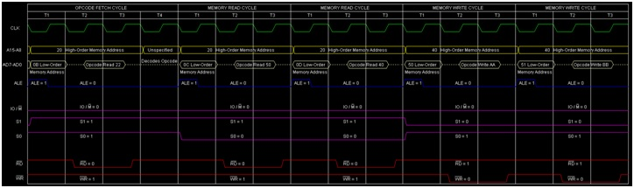
So this instruction SHLD 4050H requires 3-Bytes, 5-Machine Cycles (Opcode Fetch, Memory Read, Memory Read, Memory Write, Memory Write) and 16 T-States for execution as shown in the timing diagram.

Slide 32
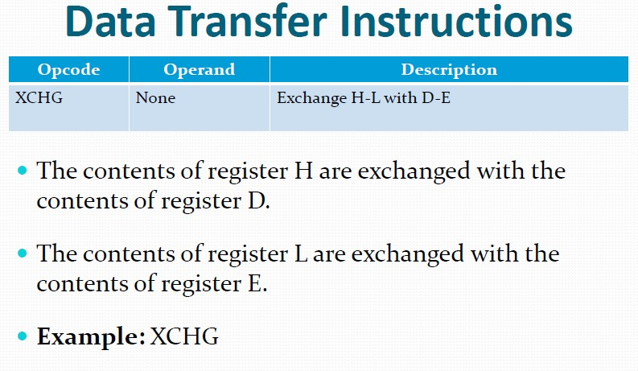
23
8085 Instruction Set

Slide 33
 | Before | After
(HL) | ABCDH | 6789H
(DE) | 6789H | ABCDH
Address | Hex Codes | Mnemonic | Comment
2006 | EB | XCHG | Swapping the contents of DE and HL register pairs
1-Byte instruction

Slide 34
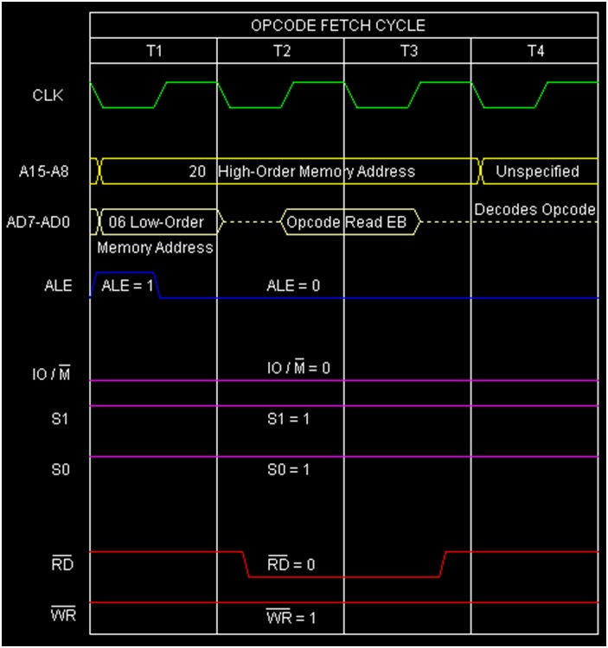

Slide 35
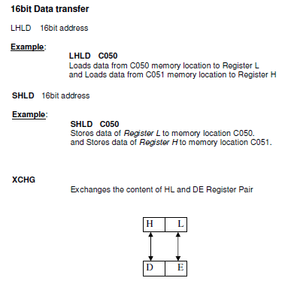
Data Transfer Instruction
24
JIIT-128, Noida

Slide 36
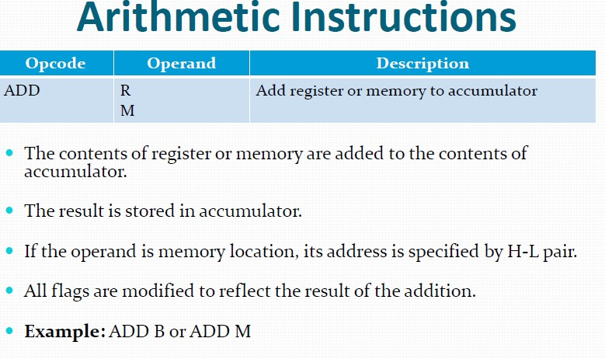
25
8085 Instruction Set

Slide 37
ADD R
R = A, B, C, D, E, H, L, or M
ADD E.
 | Before | After
(E) | 03H | 03H
(A) | 02H | 05H
Address | Hex Codes | Mnemonic | Comment
2004 | 83 | ADD E | Accumulator = Accumulator + Register E
1-Byte instruction.

Slide 38
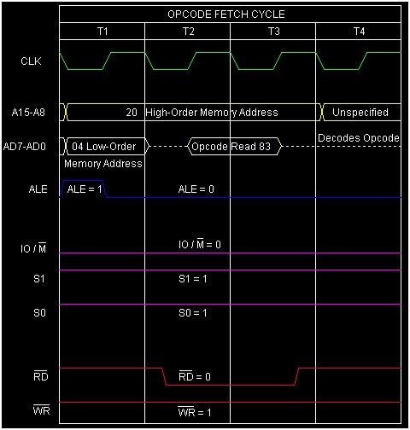

Slide 39
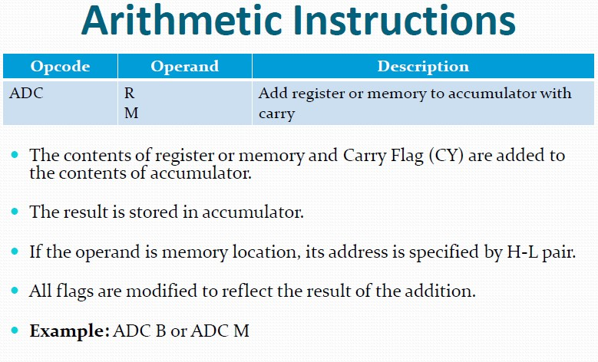
26
8085 Instruction Set

Slide 40
 | Before | After
(E) | 10H | 10H
(A) | A0H | B1H
(F) | Cy=1, Other flag bits may have any value | Cy=0,AC=0,Z=0,P=1,S=1
Address | Hex Codes | Mnemonic | Comment
2005 | 8B | ADC | Accumulator = Accumulator + E Register + Cy Flag Bit
1-Byte instruction.

Slide 41
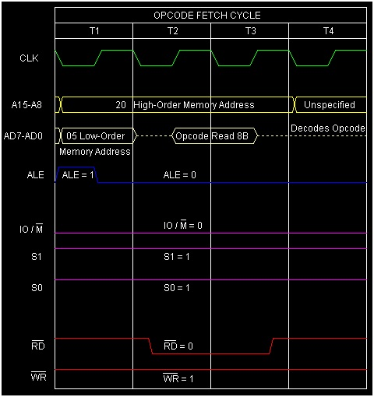

Slide 42
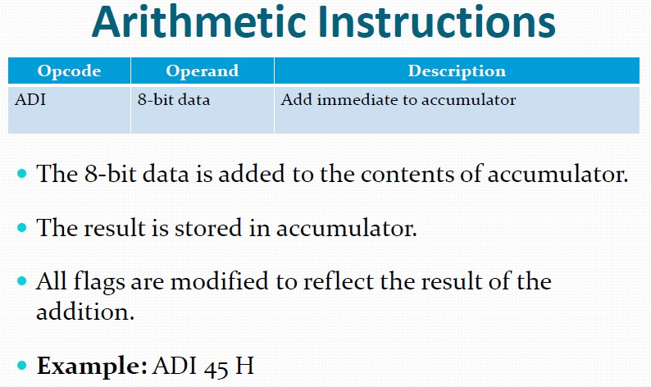
27
8085 Instruction Set

Slide 43
ADI 03H
 | Before | After
(A) | 02H | 05H
Flag Register (F) | Any values | CY=0,AC=0,S=0,P=1,Z=0
 | Before | After
(A) | 02H | 05H
Flag Register (F) | Any values | CY=0,AC=0,S=0,P=1,Z=0
 | Before | After
(A) | 02H | 05H
Flag Register (F) | Any values | CY=0,AC=0,S=0,P=1,Z=0
 | Before | After
(A) | 02H | 05H
Flag Register (F) | Any values | CY=0,AC=0,S=0,P=1,Z=0
Address | Hex Codes | Mnemonic | Comment
2002 | C6 | ADI 03H | Accumulator = Accumulator + Operand 03H
2003 | 03 |  | Data operand 03H
2-Byte instruction

Slide 44
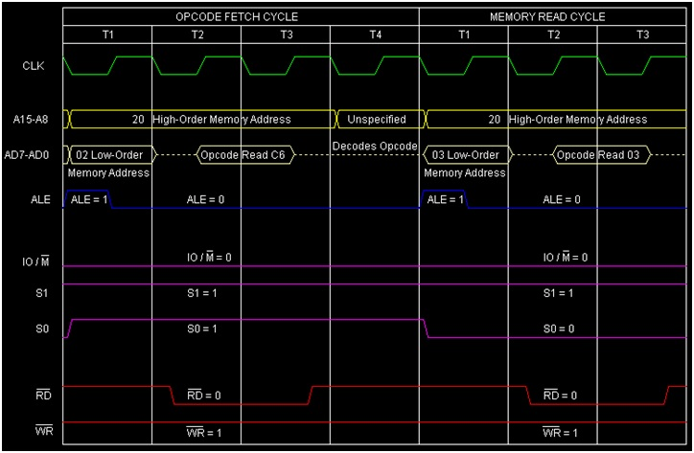

Slide 45
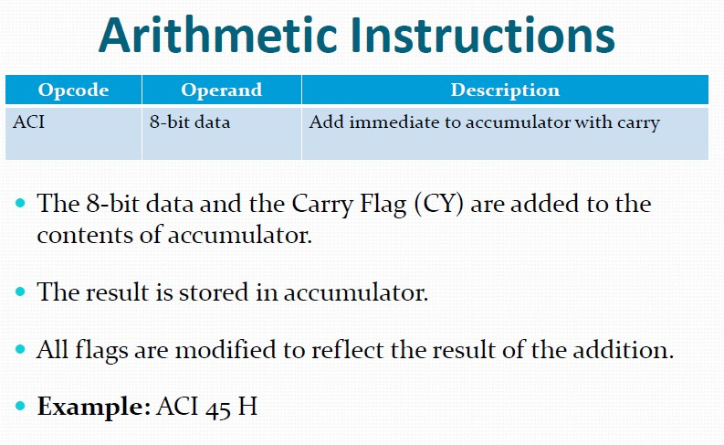
28
8085 Instruction Set

Slide 46
ACI ABH
 | Before | After
(A) | 10H | BCH
(F) | Cy=1 Other flag bits=any values | Cy=0,AC=0,S=1,P=0,Z=0
Address | Hex Codes | Mnemonic | Comment
2003 | CE | ACI AB | Accumulator = Accumulator + ABH Operand + Cy Flag Bit
2004 | AB |  | Operand ABH

Slide 47
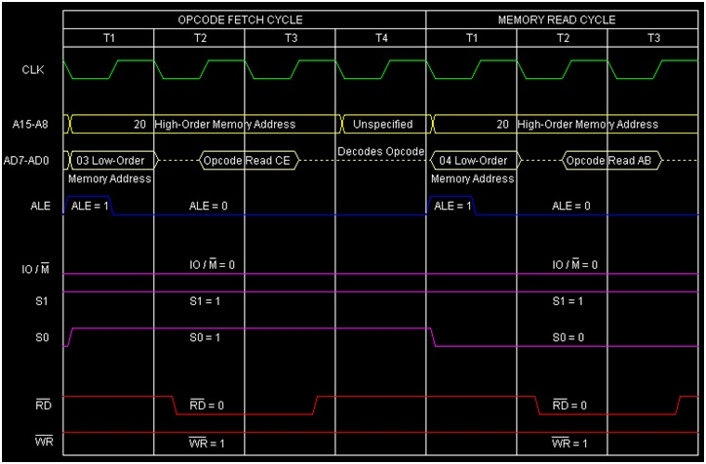
So this instruction ACI ABH requires 2-Bytes, 2-Machine Cycles (Opcode Fetch, Memory Read) and 7 T-States for execution as shown in the timing diagram.

Slide 48
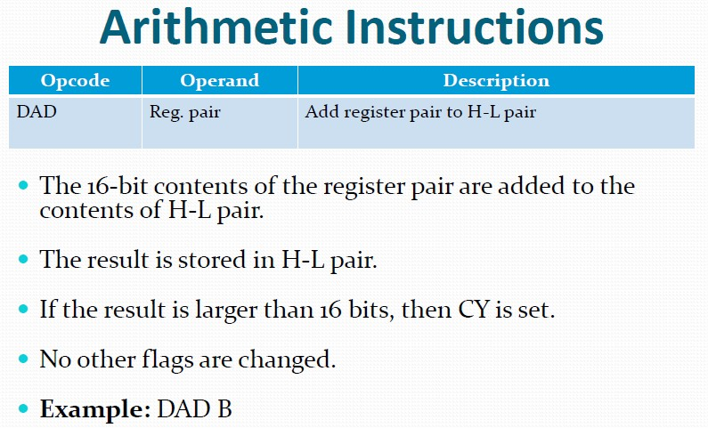
29
8085 Instruction Set

Slide 49
DAD B
 | Before | After
(HL) | 4050H | 80B0H
(BC) | 4060H | 4060H
(F) | Any values | Cy=0, no change on other flag bits
Address | Hex Codes | Mnemonic | Comment
2006 | 09 | DAD B | HL = HL + BC
1-Byte instruction

Slide 50
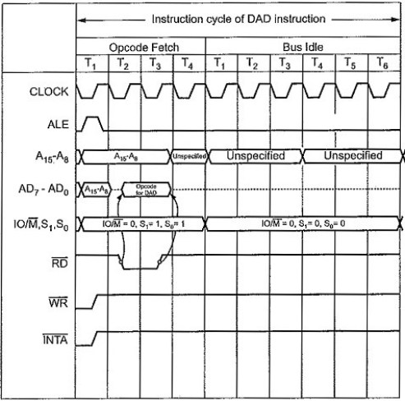
So this instruction DAD B requires 1-Byte, 3 Machine Cycle (Opcode Fetch, Bus Idle, Bus Idle) and 10 T-States for execution as shown in the timing diagram

Slide 51
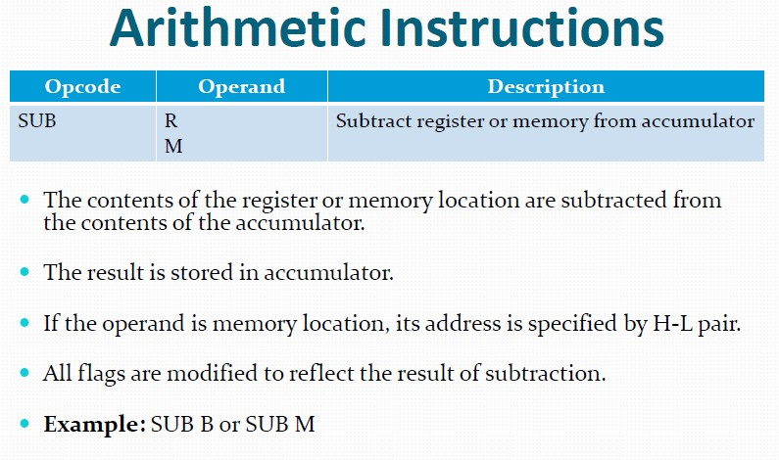
30
8085 Instruction Set

Slide 52
SUB E
 | Before | After
(A) | ABH | DEH
(E) | CDH | CDH
(F) | Any values | Cy=1,AC=0,S=1,P=1,Z=0
Address | Hex Codes | Mnemonic | Comment
2004 | 93 | SUB E | Accumulator = Accumulator + 2’s Complement of E

Slide 53
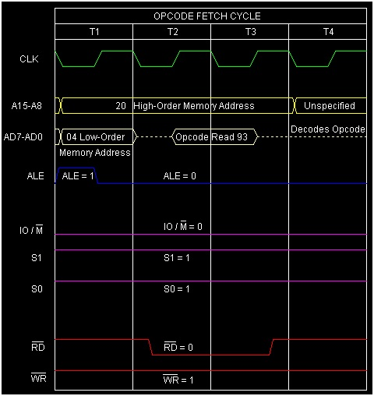
So this instruction SUB E requires 1-Byte, 1 Machine Cycles (Opcode Fetch) and 4 T-States for execution as shown in the timing diagram.

Slide 54
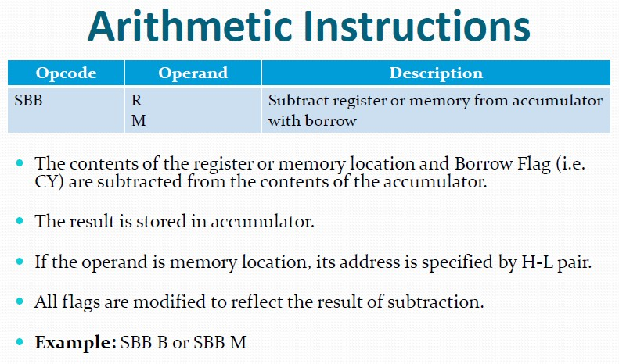
31
8085 Instruction Set

Slide 55
SBB E
 | Before | After
(E) | 13H | 13H
(A) | 44H | 30H
(F) | Cy=1, other flag bits=any value | Cy=0, AC=1,S=0,P=1,Z=0
Address | Hex Codes | Mnemonic | Comment
2005 | 9B | SBB E | A register = A register – E register – 1
1-Byte instruction

Slide 56

So this instruction SBB E requires 1-Byte, 1-Machine Cycle (Opcode Fetch) and 4 T-States for execution as shown in the timing diagram.

Slide 57
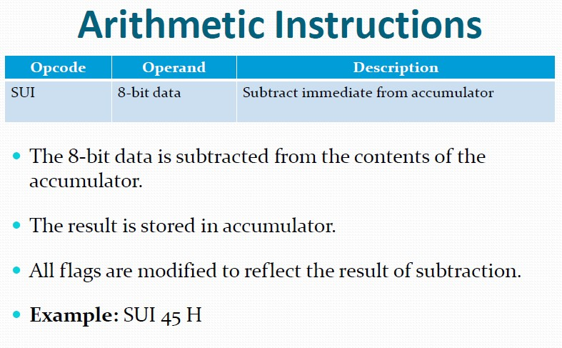
32
8085 Instruction Set

Slide 58
SUI ABH
 | Before | After
(A) | CDH | 22H
(F) | Any values | Cy=0,AC=1,S=0,P=1,Z=0
Address | Hex Codes | Mnemonic | Comment
2002 | D6 | SUI ABH | Accumulator = Accumulator + 2’s Complement of ABH
2003 | AB |  | Operand ABH
2-Byte instruction

Slide 59
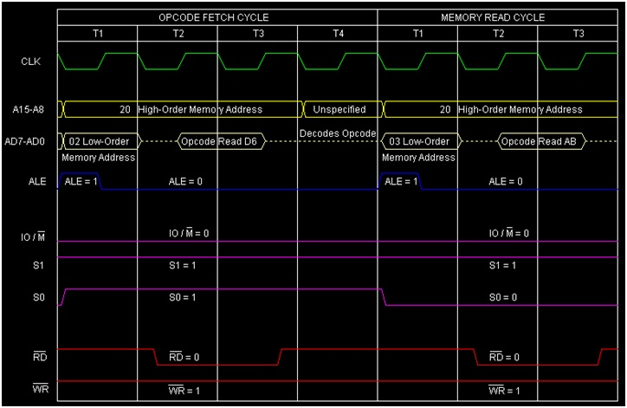
requires 2-Bytes, 2-Machine Cycles (Opcode Fetch, Memory Read) and 7 T-States for execution as shown in the timing diagram.

Slide 60
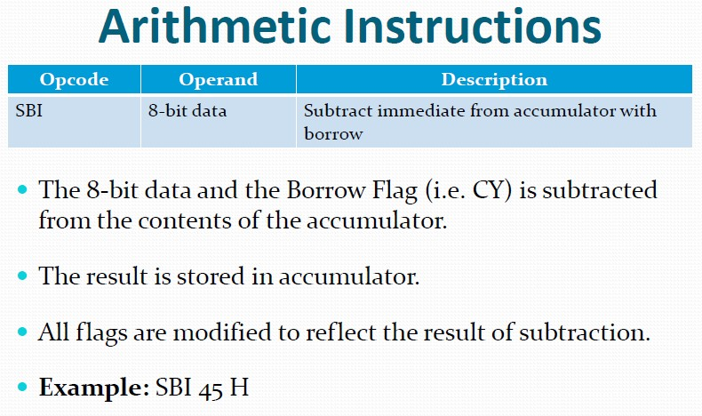
33
8085 Instruction Set

Slide 61
SBI 13H
 | Before | After
(A) | 44H | 30H
(F) | Cy=1, other flag bits=any value | Cy=0, AC=1,S=0,P=1,Z=0
Address | Hex Codes | Mnemonic | Comment
2003 | DE | SBI 13H | A register = A register – 13H – 1
2004 | 13H |  | Operand

Slide 62
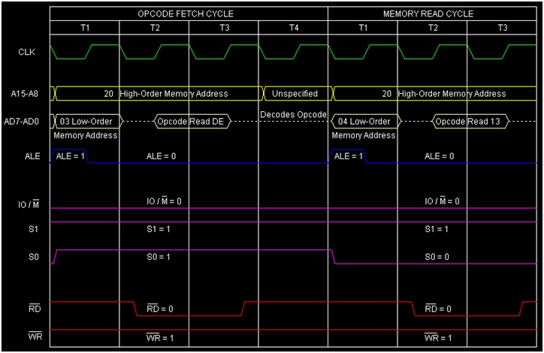
So this instruction SBI 13H requires 2-Bytes, 2 Machine Cycles (Opcode Fetch, Memory Read) and 7 T-States for execution as shown in the timing diagram.

Slide 63
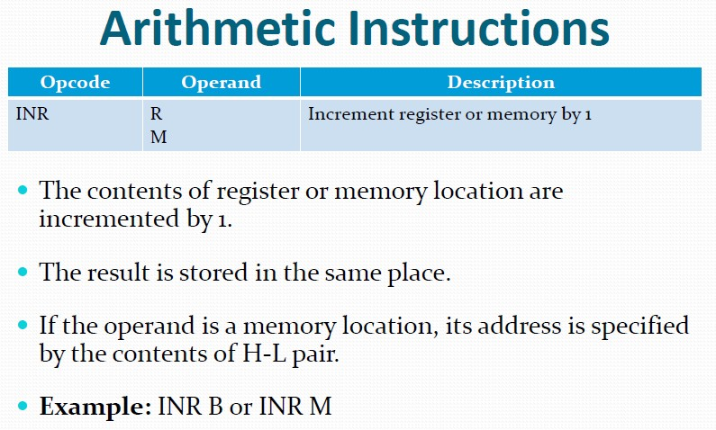
34
8085 Instruction Set

Slide 64
INR M
 | Before | After
(HL) | 4050H | 4050H
(4050H) | 05H | 06H
Flag Register (F) | Any Value | Cy=no change, Ac=0,S=0,P=1,Z=0
Address | Hex Codes | Mnemonic | Comment
2005 | 34 | INR M | (HL) = (HL) + 1, i.e. 4050H memory locations content will be increased by 1 as HL register pair is having 16-bit address 4050H

Slide 65
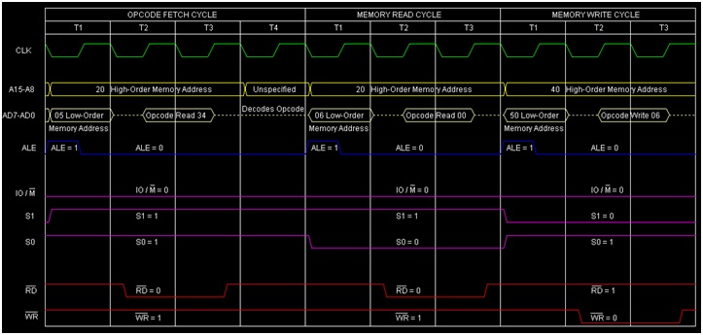
So this instruction INR M requires 1-Byte, 3-Machine Cycles (Opcode Fetch, Memory Read, Memory Write) and 10 T-States for execution as shown in the timing diagram.

Slide 66
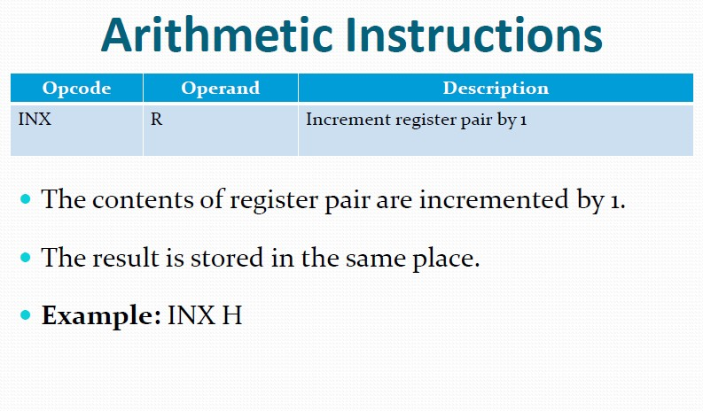
35
8085 Instruction Set

Slide 67
INX B
 | Before | After
(BC) | 4050H | 4051H
Address | Hex Codes | Mnemonic | Comment
2003 | 03 | INX B | BC = BC + 1

Slide 68
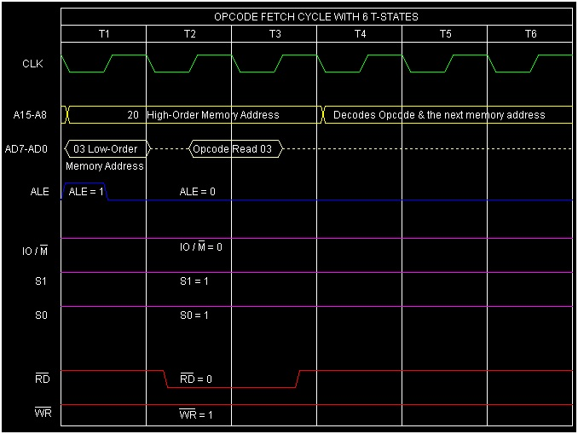
So this instruction INX B requires 1-Byte, 1-Machine Cycle (Opcode Fetch) and 6 T-States for execution as shown in the timing diagram.

Slide 69
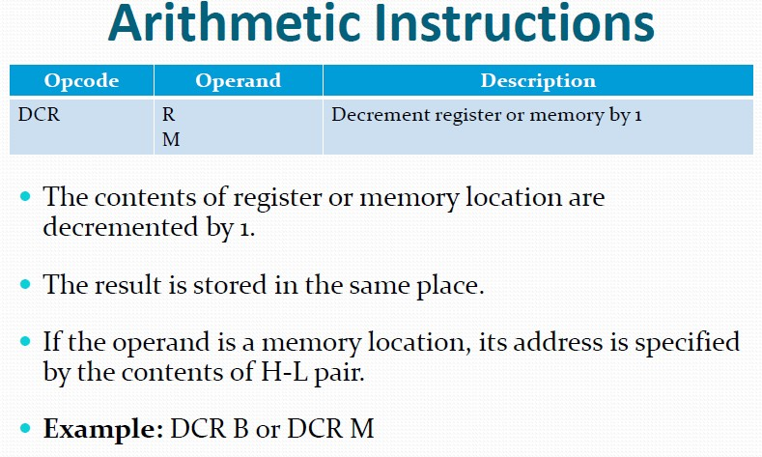
36
8085 Instruction Set

Slide 70
DCR M
 | Before | After
(HL) | 4050H | 4050H
(4050H) | ABH | AAH
(F) | Any values | Cy=no change, AC=1,S=1,P=1,Z=0
Address | Hex Codes | Mnemonic | Comment
2005 | 35 | DCR M | (HL) = (HL) - 1
1 byte instruction

Slide 71
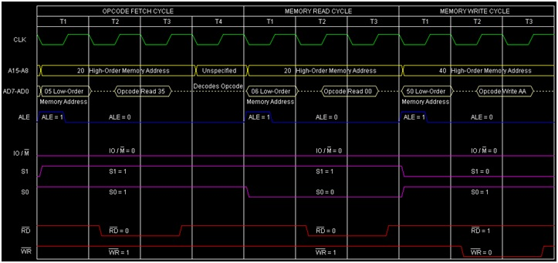
So this instruction DCR M requires 1-Bytes, 3-Machine Cycles (Opcode Fetch, Memory Read, Memory Write) and 10 T-States for execution as shown in the timing diagram.

Slide 72
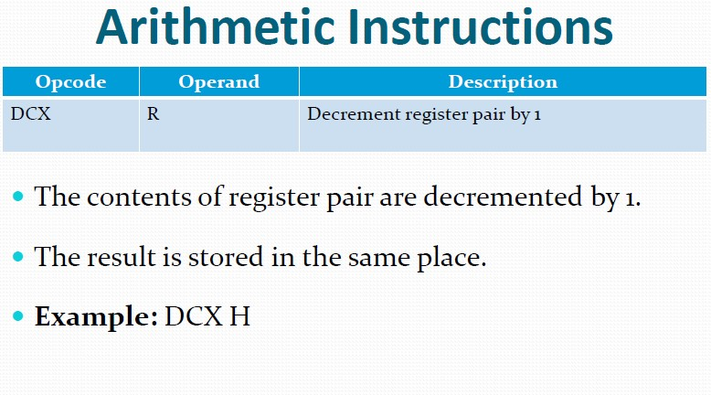
37
8085 Instruction Set

Slide 73
DCX B
 | Before | After
(BC) | 4055H | 4054H
Address | Hex Codes | Mnemonic | Comment
2003 | 0B | DCX B | BC = BC – 1
1-Byte instruction,

Slide 74
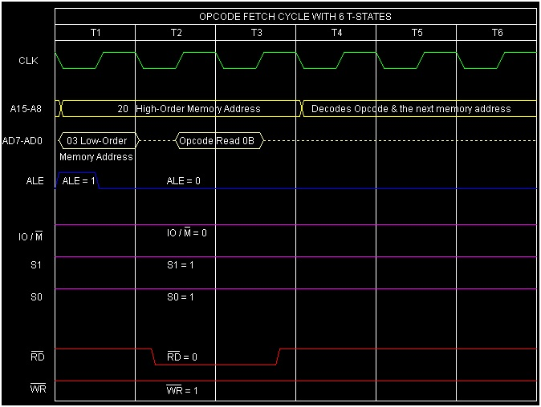
instruction DCX B requires 1-Byte, 1-Machine Cycle (Opcode Fetch) and 6 T-States for execution as shown in the timing diagram.

Slide 75
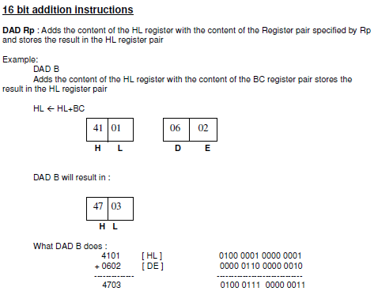
Arithmetic Instructions
38
JIIT-128, Noida

Slide 76
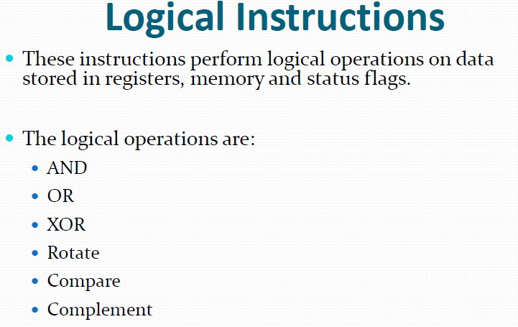
39
8085 Instruction Set

Slide 77

40
8085 Instruction Set

Slide 78

41
8085 Instruction Set

Slide 79

42
8085 Instruction Set

Slide 80

43
8085 Instruction Set

Slide 81

44
8085 Instruction Set

Slide 82

45
8085 Instruction Set

Slide 83
CMP E
 | Before | After
(A) | 50H | 50H
(E) | 70H | 70H
(Temp) | Any value | E0H
(F) | Any value | Cy=1,AC=0,S=1,P=0,Z=0
1-Byte instruction
Address | Hex Codes | Mnemonic | Comment
2004 | BB | CMP E | Temp = Register A - Register E

Slide 84


Slide 85

46
8085 Instruction Set

Slide 86

47
8085 Instruction Set

Slide 87
CPI 50H
 | Before | After
(A) | 70H | 70H
(Temp) | Any value | 20H
(F) | Any value | Cy=0,AC=0,S=0,P=0,Z=0
2-Byte instruction
Address | Hex Codes | Mnemonic | Comment
2002 | FE | CPI 50H | Temp = Register A – 50H
2003 | 50 |  | Operand 50H

Slide 88

So this instruction CPI 50H requires 2-Bytes, 2-Machine Cycles (Opcode Fetch, Memory Read) and 7 T-States for execution as shown in the timing diagram.

Slide 89

48
8085 Instruction Set

Slide 90
ANA E
 | Before | After
(E) | CDH | CDH
(A) | ABH | 89H
(F) | Any values | Cy=0,AC=1,Z=0,P=0,S=1
Address | Hex Codes | Mnemonic | Comment
2004 | A3 | ANA E | A = A and E
1-Byte instruction

Slide 91

So this instruction ANA E requires 1-Byte, 1-Machine Cycle (Opcode Fetch) and 4 T-States for execution as shown in the timing diagram.

Slide 92

49
8085 Instruction Set

Slide 93
ANI CDH
 | Before | After
(A) | ABH | 89H
(F) | Any values | Cy=0,AC=1,S=1,P=0,Z=0
The internal calculation has been done as follows −
ABH ---> 1010 1011
(d8) CDH ---> 1100 1101 ---------
ANI CDH ---> 1000 1001 (89H)
Address | Hex Codes | Mnemonic | Comment
2002 | E6 | ANI CD | A = A and CDH
2003 | CD |  | Operand CDH

Slide 94

So this instruction ANA E requires 2-Bytes, 2 Machine Cycles (Opcode Fetch, Memory Read) and 7 T-States for execution as shown in the timing diagram.

Slide 95

50
8085 Instruction Set

Slide 96
ORA E
 | Before | After
(E) | CDH | CDH
(A) | ABH | EFH
(F) | Any values | Cy=0,AC=0,S=1,P=0,Z=0
The internal calculation has been done as shown below −
ABH ---> 1010 1011
(E) CDH ---> 1100 1101 ---------
ORA E ---> 1110 1111 (EFH)
Address | Hex Codes | Mnemonic | Comment
2004 | B3 | ORA E | A = A OR E
1-Byte instruction

Slide 97

So this instruction ORA E requires 1-Byte, 1-Machine Cycle (Opcode Fetch) and 4 T-States for execution as shown in the timing diagram.

Slide 98

51
8085 Instruction Set

Slide 99
ORI CDH
 | Before | After
(A) | ABH | EFH
(F) | Any values | Cy=0,AC=0,S=1,P=0,Z=0
The internal calculation has been done as shown below −
ABH ---> 1010 1011 (
d8) CDH ---> 1100 1101 ---------
ORI CDH ---> 1110 1111 (EFH)
Address | Hex Codes | Mnemonic | Comment
2002 | F6 | ORI CDH | A = A or CDH
2003 | CD |  | Operand CDH
2-Byte instruction

Slide 100

So this instruction ORI CDH requires 2-Bytes, 2-Machine Cycles (Opcode Fetch, Memory Red) and 7 T-States for execution as shown

Slide 101

52
8085 Instruction Set

Slide 102
XRA E
 | Before | After
(E) | CDH | CDH
(A) | ABH | 66H
(F) | Any values | Cy=0,AC=0,S=0,P=1,Z=0
The internal calculation has been done as shown below −
(A) ABH ---> 1010 1011 (E) CDH ---> 1100 1101 --------- XRAE --->0110 0110 (66H)
Address | Hex Codes | Mnemonic | Comment
2004 | AB | XRA E | A = A XOR E
1-Byte instruction

Slide 103

So this instruction XRA E requires 1-Byte, 1-Machine Cycle (Opcode Fetch) and 4 T-States for execution as shown in the timing diagram.

Slide 104

53
8085 Instruction Set

Slide 105
XRI CDH
 | Before | After
(A) | ABH | 66H
(F) | Any values | Cy=0,AC=0,S=0,P=1,Z=0
The internal calculation has been done as shown below −
(A) ABH ---> 1010 1011 (d8) CDH ---> 1100 1101 --------- XRICDH --->0110 0110 (66H)
Address | Hex Codes | Mnemonic | Comment
2002 | EE | XRI CDH | A = A XOR CDH
2003 | CD |  | Operand CDH

Slide 106

So this instruction ORI CDH requires 2-Bytes, 2-Machine Cycles (Opcode Fetch, Memory Read) and 7 T-States for execution as shown in the timing diagram.

Slide 107

54
8085 Instruction Set

Slide 108

Logical Instructions
55
JIIT-128, Noida

Slide 109
 | Before | After
(A) | 35H | 6BH
(Cy) | 1 | 0
35H ---> 0011 0101
0 0110 1011 ---> 6BH(Prev. Cy bit as the Last bit)
Address | Hex Codes | Mnemonic | Comment
2003 | 17 | RAL | RotateAccumulator Left

Slide 110

ss
So this instruction RAL requires 1-Byte, 1-Machine Cycle (Opcode Fetch) and 4 T-States for execution as shown in the timing diagram.

Slide 111

5
6
8085 Instruction Set

Slide 112

Logical Instructions
57
JIIT-128, Noida

Slide 113
 | Before | After
(A) | 8AH | C5H
(Cy) | 1 | 1
8AH ---> 1000 1011
1100 0101 --->C5H (Last bit 1 is copied to Cy bit) (And initial Cy=1 bit at the MS place)
Address | Hex Codes | Mnemonic | Comment
2003 | 1F | RAR | Rotate Accumulator Right

Slide 114

ss
So this instruction RAR requires 1-Byte, 1-Machine Cycle (Opcode Fetch) and 4 T-States for execution as shown in the timing diagram.

Slide 115

58
8085 Instruction Set

Slide 116

Logical Instructions
59

Slide 117
 | Before | After
(A) | 35H | 6AH
(Cy) | Any value | 0
35H ---> 0011 0101
0 0110 1010 ---> 6AH
Address | Hex Codes | Mnemonic | Comment
2002 | 07 | RLC | Rotate Left Accumulator

Slide 118

So this instruction RLC requires 1-Byte, 1-Machine Cycle (Opcode Fetch) and 4 T-States for execution as shown in the timing diagram.

Slide 119

60
circular right shift
8085 Instruction Set

Slide 120

Logical Instructions
61
JIIT-128, Noida

Slide 121
 | Before | After
(A) | 8AH | 45H
(Cy) | Any Value | 0
8AH ---> 1000 1010
0100 0101 ---> 45H (Last bit 0 is copied to Cy bit)
Address | Hex Codes | Mnemonic | Comment
2002 | 0F | RRC | Rotate Right Accumulator

Slide 122

ss
So this instruction RRC requires 1-Byte, 1-Machine Cycle (Opcode Fetch) and 4 T-States for execution as shown in the timing diagram.

Slide 123

62
8085 Instruction Set

Slide 124

63
8085 Instruction Set

Slide 125

64
8085 Instruction Set

Slide 126

65
8085 Instruction Set

Slide 127

66
8085 Instruction Set

Slide 128
Opcode | Operand | Meaning | Explanation
JMP | 16-bit address | Jump unconditionally | The program sequence is transferred to the memory address given in the operand.
Address | Hex Codes | Mnemonic | Comment
2000 | C3 | JMP 4000H | Unconditionally Jump to the memory address 4000H
2001 | 00 |  | Low order Byte of the address
2002 | 40 |  | High order Byte of the address

Slide 129

So this instruction JMP requires 3-Bytes, 3-Machine Cycles (Opcode Fetch, Memory Read, MemoryRead) and 10 T-States for execution as shown in the timing diagram.

Slide 130

67
Timing diagram will be same for all as JMP
8085 Instruction Set

Slide 131

Jump Instructions
68
Timing diagram will be same for all as JMP

Slide 132

69
8085 Instruction Set

Slide 133

Call Instructions--Conditional
70
JIIT-128, Noida

Slide 134

71
8085 Instruction Set

Slide 135

Return Instructions--Conditional
72
JIIT-128, Noida

Slide 136

73
8085 Instruction Set

Slide 137

74
8085 Instruction Set

Slide 138

75
8085 Instruction Set

Slide 139

76
8085 Instruction Set

Slide 140

Stack, I/O, and Machine Control Instructions.
Stack related instruction

Slide 141

Stack, I/O, and Machine Control Instructions cont..

Slide 142

Stack, I/O, and Machine Control Instructions cont..

Slide 143

Stack, I/O, and Machine Control Instructions cont..

Slide 144

Stack, I/O, and Machine Control Instructions cont..

Slide 145

Stack, I/O, and Machine Control Instructions cont..
I/O related instruction

Slide 146

Stack, I/O, and Machine Control Instructions cont..

Slide 147

Stack, I/O, and Machine Control Instructions cont..
84
Machine control instruction
RIM (Read interrupt mask)
JIIT-128, Noida

Slide 148

Stack, I/O, and Machine Control Instructions.
SIM (Set interrupt mask)
85
JIIT-128, Noida

Slide 149
References
Gaonkar, R. S. (1990). Microprocessor Architecture, Programming and Applications with the 8085. Fifth Edition Prentice Hall PTR.

